Slide 1
Automated Matching for IC Images -- Preliminary and Refinement
Jiawei Gao
July.29th, 2019

Slide 2
Work steps
1. reconstruct a 3D model from pictures
2. match with the reference

Slide 3
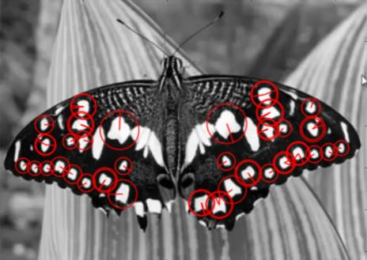
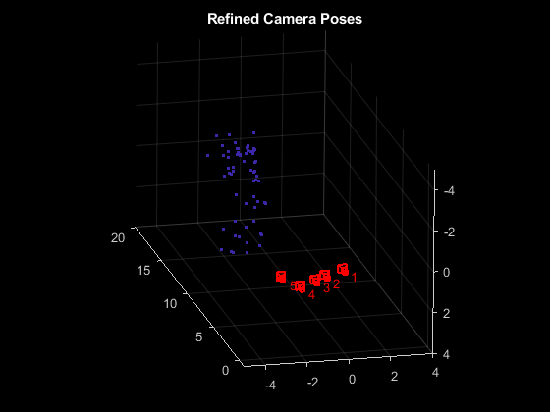
Reconstruct 3D model
Structure from motion (SfM)
1. Detect SURF features
2. Match points between the previous and the current image
3. Compute the camera pose
4. Triangulate the initial 3-D world points

Slide 4
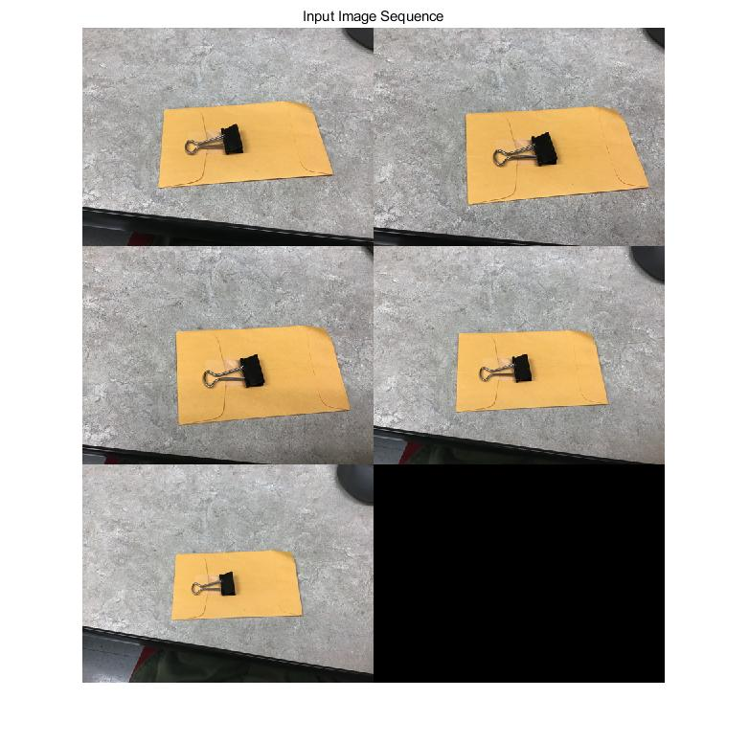
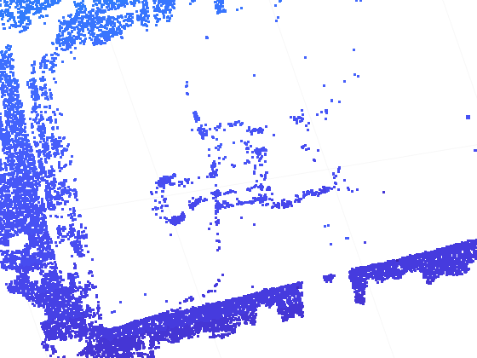
Reconstruct 3D model
The result of the reconstruction is very rough and not fine enough.

Slide 5
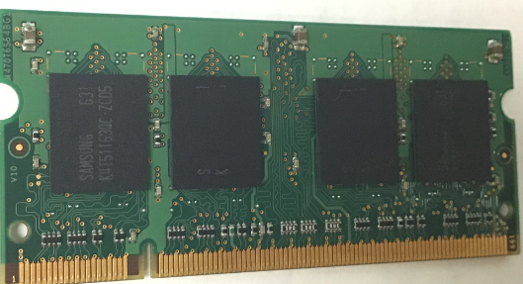
Reconstruct 3D model
Two problems:
1. Not enough SURF points in different images
2. Too many useless points

Slide 6
Calculate norm map of scanned images
Manual coarse alignment:
1. Calculate the rotate angle by hand and rotate back to right position.
2. Crop out one chip in 4 scan directions.
3. Calculate the norm map.

Slide 7
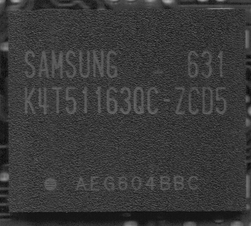
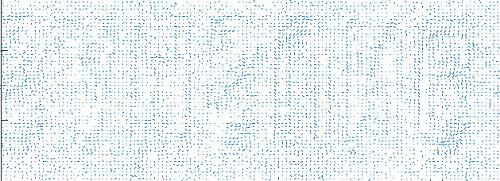
Result of Norm map’s text region
Upside down "Samsung"

Slide 8
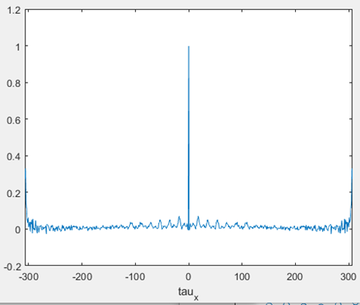
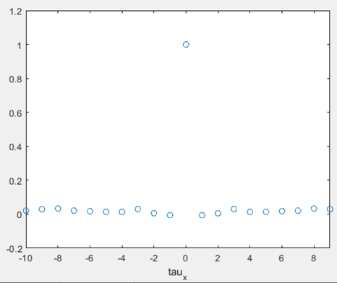
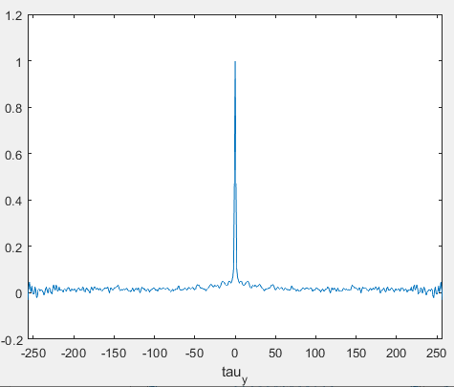
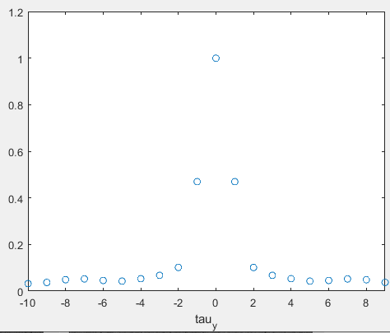
The autocorrelation of Norm map X
There are periodicities along the x direction.
Offset by one pixel, the autocorrelation coefficient drops significantly

Slide 9
The height map provided by confocal microscope
The pixels of the microscope are about ten times smaller than the scanner.

Slide 10
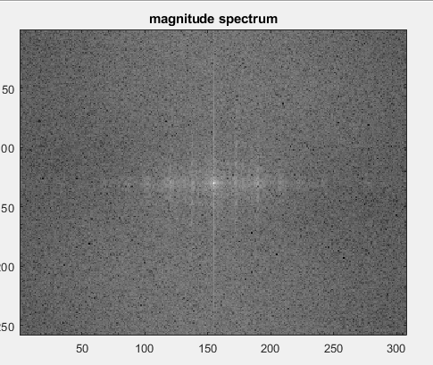
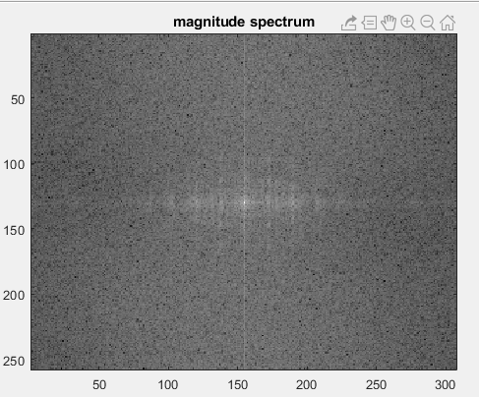
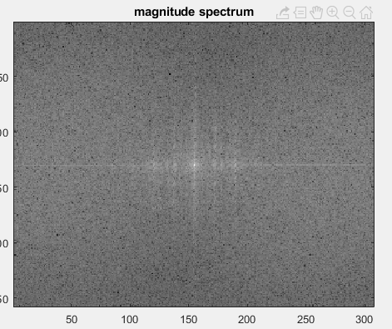
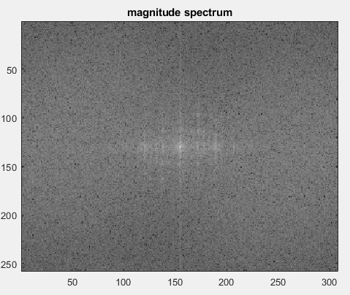
2D FFT of chip1 in 4 directions
The periodicity can still be observed in the x direction.

Slide 11
Calculate norm map of scanned images
More accurate preliminary alignment
The function imregcorr in Matlab
Reddy, B. S. and Chatterji, B. N., An FFT-Based Technique for Translation, Rotation, and Scale-Invariant Image Registration, IEEE Transactions on Image Processing, Vol. 5, No. 8, August 1996

Slide 12
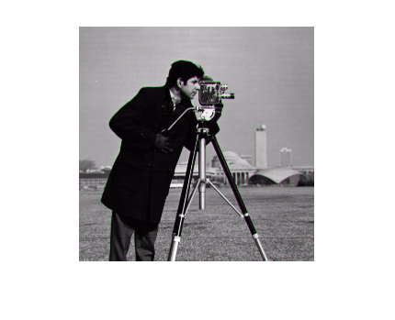
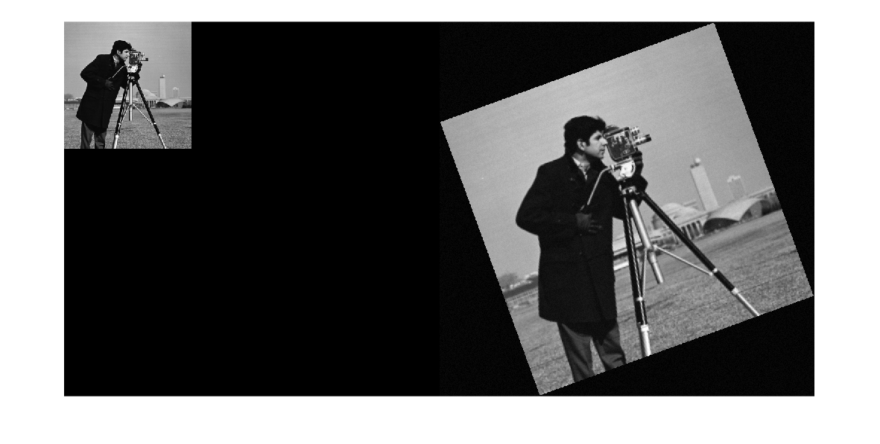
imregcorr
Original image
Translated, rotated and scaled image

Slide 13
imregcorr
1. Translation
2. Translation and rotation
3. Translation, rotation and scaling

Slide 14
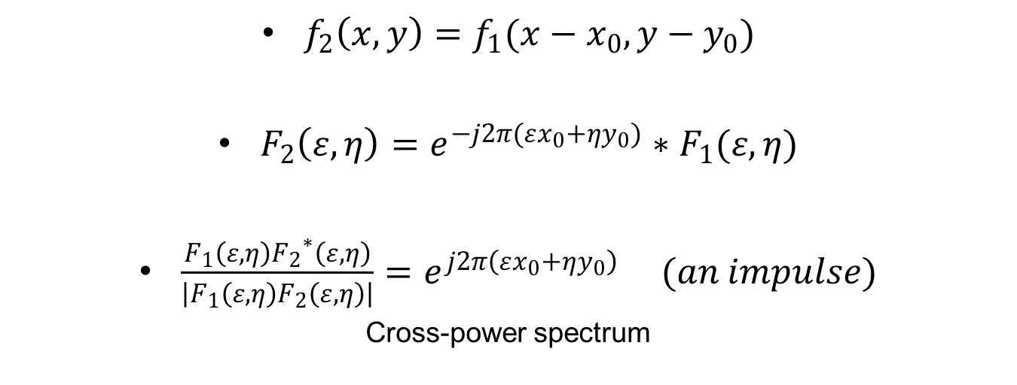
Translation
$f_{2}\left(x,y\right)=f_{1}(x−x_{0},y−y_{0})$
$F_{2}\left(ε,η\right)={e^{−j2π(εx_{0}+ηy_{0})}∗F}_{1}(ε,η)$
$\frac{F_{1}\left(ε,η\right){F_{2}}^{∗}\left(ε,η\right)}{\left|F_{1}\left(ε,η\right)F_{2}\left(ε,η\right)\right|}=e^{j2π\left(εx_{0}+ηy_{0}\right)} (an impulse)$
Cross-power spectrum

Slide 15
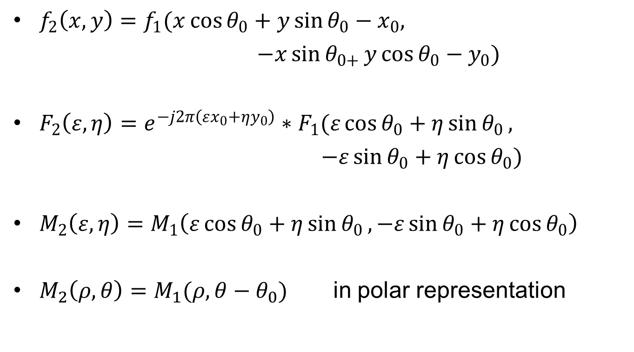
Translation and rotation
$f_{2}\left(x,y\right)=f_{1}(x\cos{θ_{0}+y\sin{θ_{0}}}−x_{0},$
$−x\sin{θ_{0+}}y\cos{θ_{0}}−y_{0})$
$F_{2}\left(ε,η\right)={e^{−j2π\left(εx_{0}+ηy_{0}\right)}∗F}_{1}(ε\cos{θ_{0}}+η\sin{θ_{0}},$
$−ε\sin{θ_{0}}+η\cos{θ_{0}})$
$M_{2}\left(ε,η\right)=M_{1}\left(ε\cos{θ_{0}}+η\sin{θ_{0}},−ε\sin{θ_{0}}+η\cos{θ_{0}}\right)$
$M_{2}\left(ρ,θ\right)=M_{1}(ρ,θ−θ_{0})$ in polar representation

Slide 16
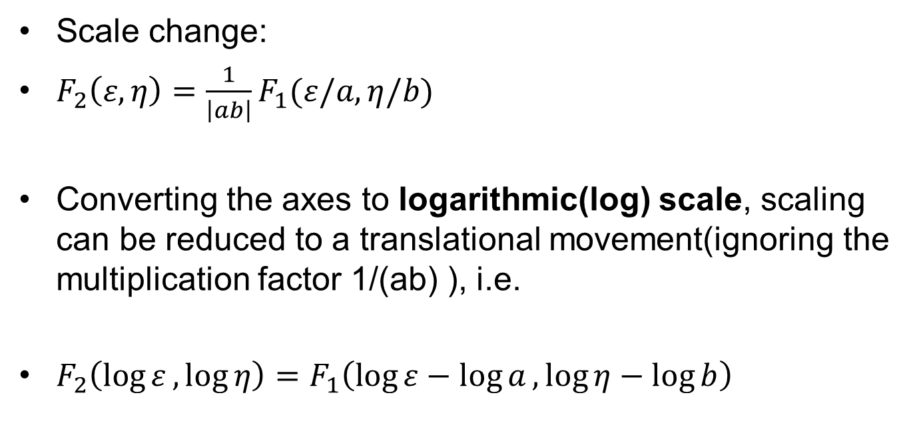
Scaling
Scale change:
$F_{2}\left(ε,η\right)=\frac{1}{\left|ab\right|}F_{1}(ε/a,η/b)$
Converting the axes to logarithmic(log) scale, scaling can be reduced to a translational movement(ignoring the multiplication factor 1/(ab) ), i.e.
$F_{2}\left(\log{ε},\log{η}\right)=F_{1}\left(\log{ε}−\log{a},\log{η}−\log{b}\right)$

Slide 17
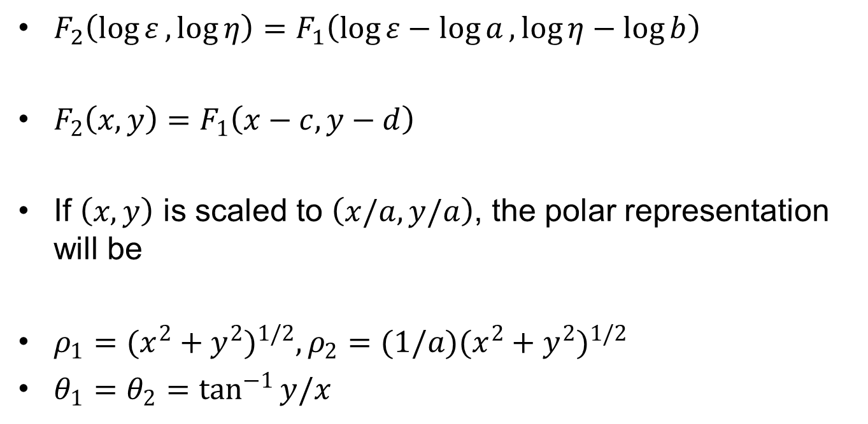
Scaling
$F_{2}\left(\log{ε},\log{η}\right)=F_{1}\left(\log{ε}−\log{a},\log{η}−\log{b}\right)$
$F_{2}\left(x,y\right)=F_{1}\left(x−c,y−d\right)$
If $\left(x,y\right)$ is scaled to $\left(x/a,y/a\right)$, the polar representation will be
$ρ_{1}={(x^{2}+y^{2})}^{1/2}, ρ_{2}=(1/a){(x^{2}+y^{2})}^{1/2}$
$θ_{1}=θ_{2}=\tan^{−1}{y/x}$

Slide 18
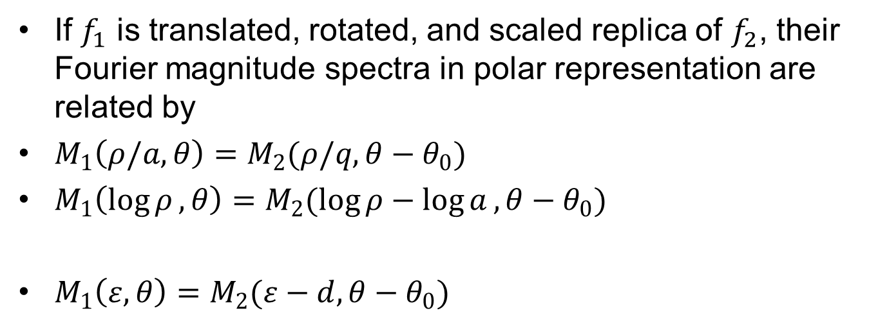
Scaling
If $f_{1}$ is translated, rotated, and scaled replica of $f_{2}$, their Fourier magnitude spectra in polar representation are related by
$M_{1}\left(ρ/a,θ\right)=M_{2}(ρ/q,θ−θ_{0})$
$M_{1}\left(\log{ρ},θ\right)=M_{2}(\log{ρ}−\log{a},θ−θ_{0})$
$M_{1}\left(ε,θ\right)=M_{2}(ε−d,θ−θ_{0})$

Slide 19
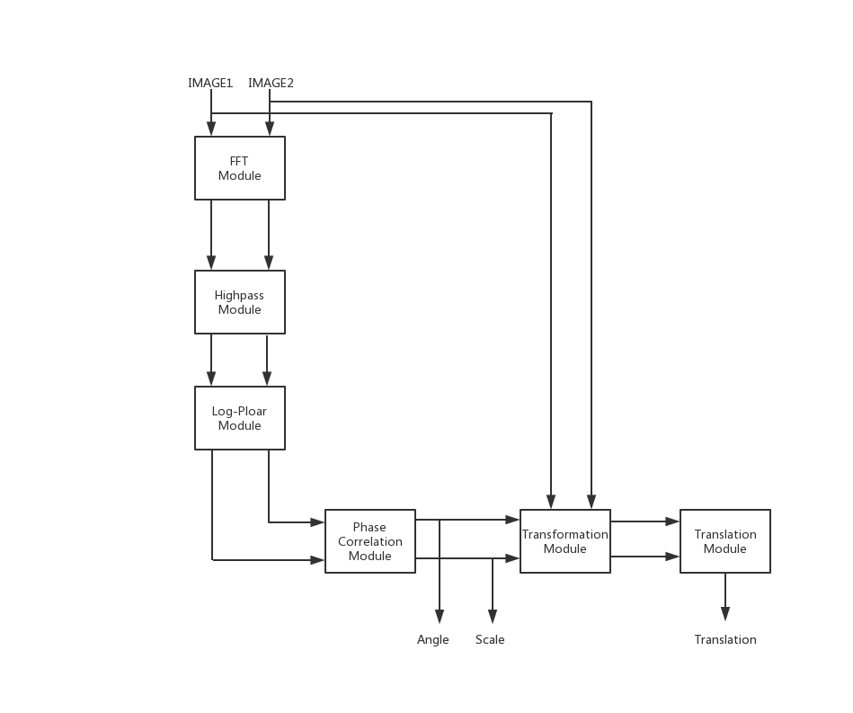
Overview of the registration algorithm

Slide 20
Calculate norm map of scanned images
Use one chip’s image to align all images, calculate the ideal template for each chip separately.

Slide 21
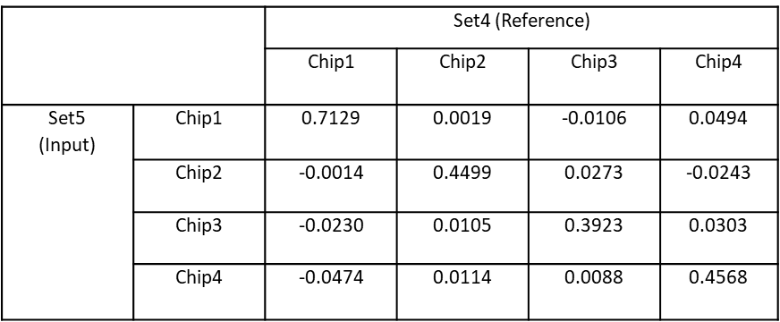
Calculate norm map of scanned images
Correlation for Norm map X
The results show that the correlation of different chips is lower than the correlation of the same chip, no matter background or text regions.

Slide 22
Thank you

